Slide 1


End of Year
NEWSLETTER
Dear Families,
I can’t believe how quickly this year has flown by, it seems like only a few weeks ago we were welcoming our children into their new classes!
It has been great to see so many parents and carers being able to come into school and join us for a host of events this half term!
There have been lots of exciting and fun learning activities already packed into, what we’re sure will feel like a short space of time, including our Daddy’s stay and play in Nursery, New starters induction evening, Y4 violin concert, Eid celebrations, European countries week and a number of class assemblies!
Our Summer Fayre will be taking place on Friday 5th July from 2pm, we would love to see as many parents/carers as possible coming to support the event and enjoy the many activities/ stalls we will have on offer, including our Y6 pupils stalls. Also make sure you look out for our Christ Church Art gallery, displaying some of the wonderful artwork children have been doing across the school!
In the last few weeks we still have a few events to look forward to with Sports Days, with Nursery (Tuesday 9th July ), KS2 (Wednesday 10th July afternoon 1.30pm) and EYFS/KS1 (Thursday 11th July afternoon 1.30pm). We also have our Y6 performances taking place (Tuesday 16th July) as well as our Year 6 children preparing for the next chapter in their educational journey, with many children having induction activities with their new high schools.
We will be welcoming some new members of staff with Mr Graves and Ms Ford joining our fantastic team of teaching staff. We are delighted to have them on board and know they will be a great asset to our Christ Church family.
I would like to take this opportunity to thank you all for your support this year and wish you all a wonderful Summer break!
Mr L Archer

Slide 2
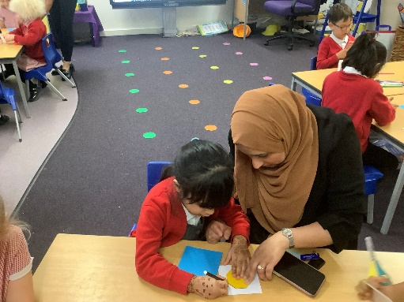
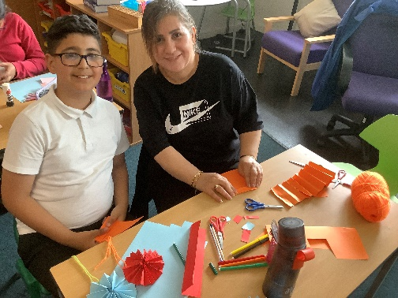
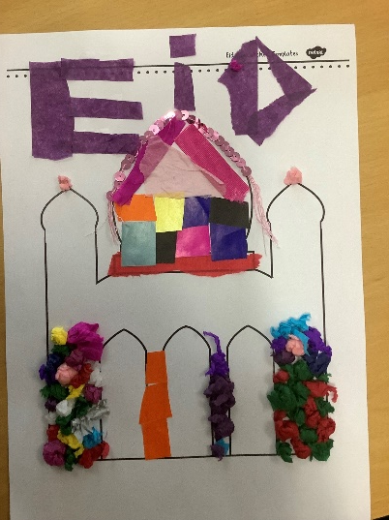
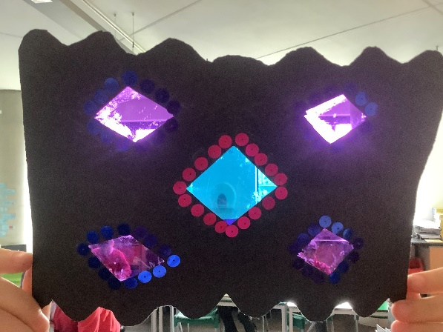
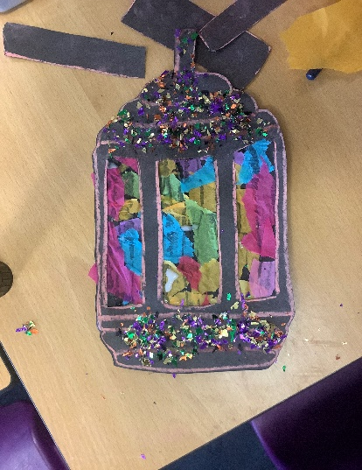
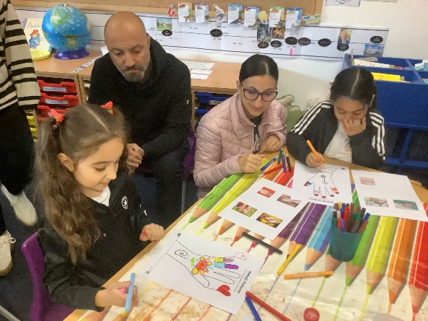
End of Year
NEWSLETTER
Eid celebrations
It has been lovely to welcome so many of our parents and carers into school to share our Eid celebration activities. We had some lovely comments from both parents and children about how much fun they had!

Slide 3
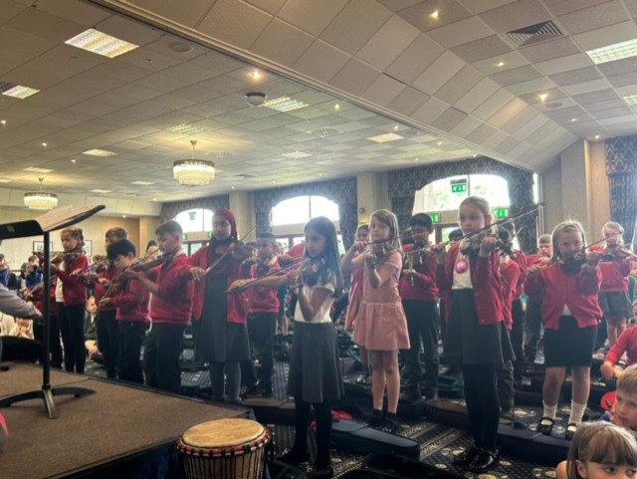
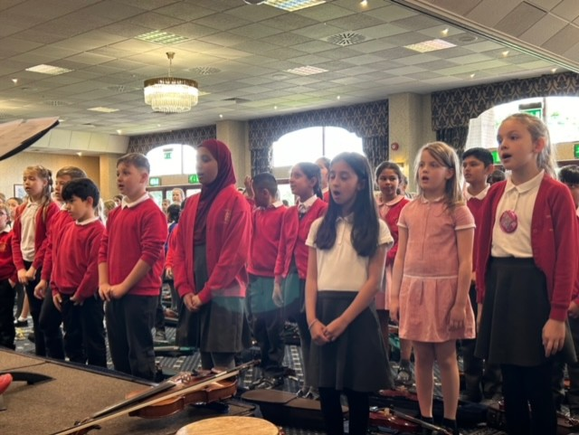
End of Year
NEWSLETTER
EH4 Violin concert
EH4 went to the Staffordshire County Showground to take part in a county music performance to a live audience. Not only did they produce a fantastic performance they also demonstrated the Christ Church MASTER values with great pride!
Here’s what some of the children in EH4 had to say:
‘We loved performing the music we have been learning to a big audience'
'The concert was great, I love playing the violin'
'I enjoyed watching other schools perform'

Slide 4
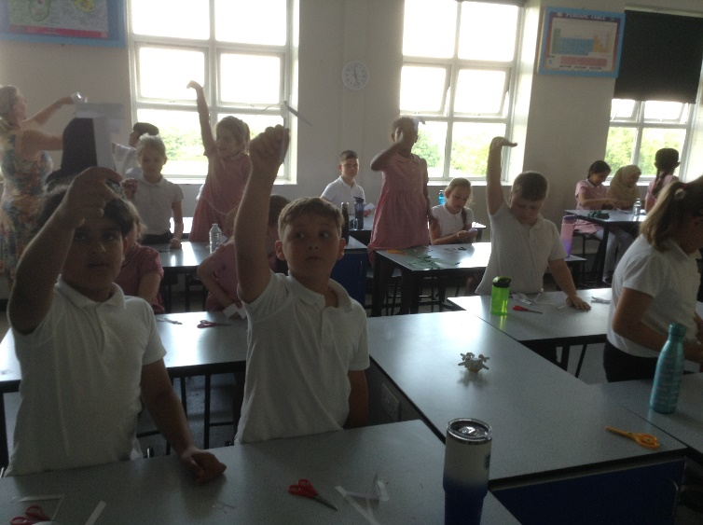
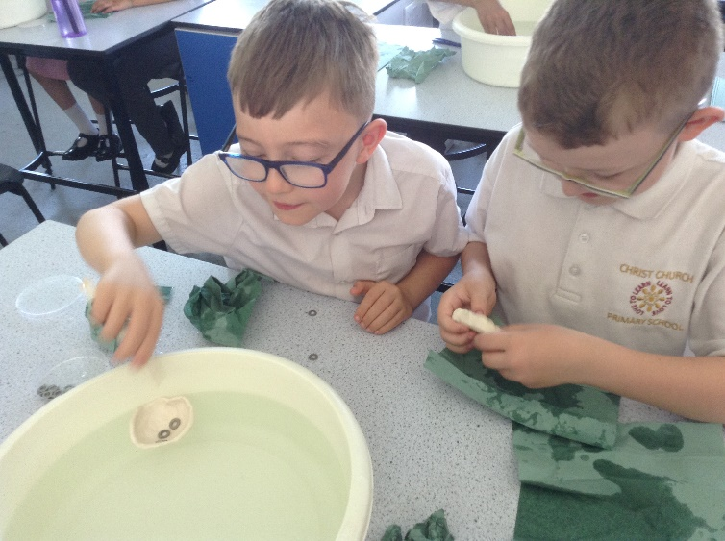
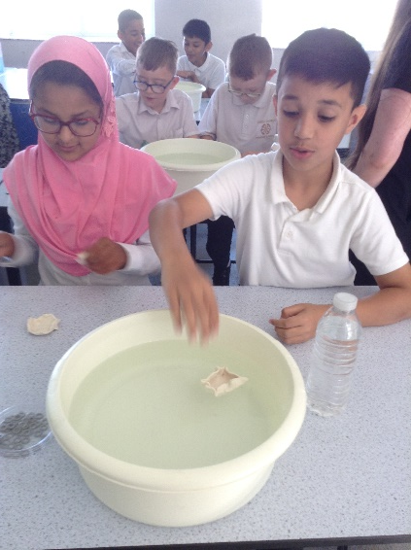
End of Year
NEWSLETTER
EH4 Science at Abbot Beyne
EH4 went to Abbot Beyne Secondary School tp take part in a variety of science activities. All the children really enjoyed taking part, especially with the practical investigations.
'We went to Abbot Beyne and did some fun Science investigations. We had to make a boat out of plasticine to see how many passengers we could save. We looked at the weight of the boat and spreading out the weight so that it would float.'

Slide 5



End of Year
NEWSLETTER
W2 Class Assembly
W2 performed their class assembly, showing off some of the wonderful learning they have been doing over the past half term.
Here’s what they had to say afterwards:
Adam: It was amazing and brilliant fun!
Suhab: It was super showing everyone what he have learned this term!
Yusuf : I was so proud of our singing in the assembly!
Hana: It was brilliant because we could show our grown ups , teachers and the other children our assembly!

Slide 6
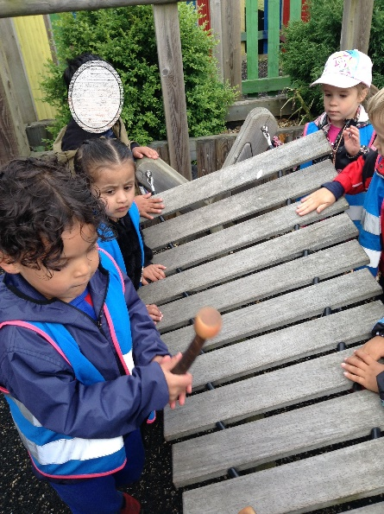
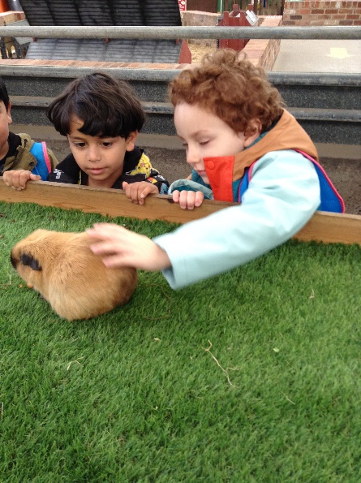
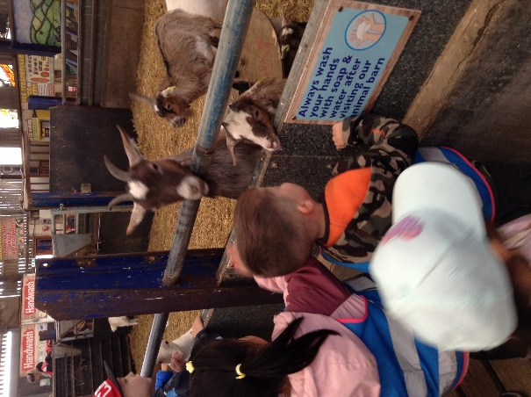
End of Year
NEWSLETTER
Nursery Farm Visit
All of our nursery children visited the Adventure farm this week. We had a wonderful day full of lots to do! We saw lots of farm animals and helped the farmers feed them. We used our kind hands to pet the Guinea pigs and learnt how you take care of the animals. We made sure we washed our hands after.
"The guinea pigs are so cute and fluffy." Afia
"Look, pig, oink oink!" Leonas
"Goats tongue tickles!" Aisha
"Its the biggest pig I've ever seen! Ella
"They are so hungry" Ziddy
"Can we come again?!" Arwin
Our Nursery children had lots of fun and they behaved brilliantly! Well done Nursery!

Slide 7
End of Year
NEWSLETTER
So to a fond farewell to our fantastic Year 6. Over the year we have had some ups and downs but you have been truly amazing.
With the MASTER school values you have demonstrated you have the foundations you need for the next stage of your learning journeys. We wish each and every one of you success in your many different High Schools. We know you will continue to be wonderful students. You have been fun, resilient and hardworking at home and at school. We will miss you all.
Thank you to all the staff that have helped you on your way and to our families for the wonderful support they give to us all.
We hope you remember to:
‘Love to learn and learn to love’
Good luck in all you do!

Slide 8

End of Year
NEWSLETTER
Calendar dates
Summer Term 2024
Summer Fayre - Friday 5th July
Sports Day Nursery - Tuesday 9th July
Sports Day KS2 –Wednesday 10th July at 1:30pm
Sports Day KS1/EYFS- Thursday 11th July at 1:30pm
LAST DAY children in school – Friday 19th July
Inset Day (school closed): Monday 22nd July
Holiday: Tuesday 23rd July – Friday 30th August
Next School Year Sept 2024-July 2025
INSET DAYS/Bank Holiday
Mon 2nd September 2024
Tues 3rd September 2024
Mon 5th May 2025 –MAY DAY
Fri 25th October 2024
Mon 2nd June 2025
Mon 21st July 2025
Term Dates
Autumn Term 2024
4th September- 25th October
4th November – 20th December
Spring Term 2025
6th January- 14th February
24th February- 11th April
Summer Term 2025
28th April- 23rd May
2nd June-21st July

