Slide 1
Welcome & Introductions
Keddie Bailey:
Parent Support Co-ordinator
& Hope Mentor

Slide 2
Anxiety in children and how to support

Slide 3
What is anxiety
Anxiety is a feeling of worry or fear that is experienced as a combination of physical sensations, thoughts and feelings.
All children and young people feel worried sometimes, and this is a normal part of growing up. At certain points, such as on their first day of school or before an exam, young people may become more worried, but will soon be able to calm down and feel better.
Anxiety can become a problem when a child or young person feels stuck in it, or when it feels like an overwhelming, distressing or unmanageable experience. If this kind of worrying goes on for a long time, it can leave a young person feeling exhausted and isolated and limit the things they feel able to do.

Slide 4
7 types of Anxiety Disorders:
Generalised Anxiety Disorder: intense worrying most days
Panic Attacks
Specific Phobias: dark, vomiting needles
Complex Phobias: social phobia agoraphobia
Separation Anxiety
Health Anxiety
Obsessive Compulsive Disorder

Slide 5
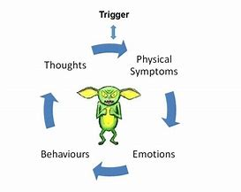

Slide 6
How to Help your child -
Acitivity
Where does it hurt ?
What happens to our body ?
Younger children may not easily recognise that what they are feeling is worry, fear or anxiety.
But they may be able to say they feel upset or sad and they may describe physical feelings.

Slide 7
Negative Symptoms:
Cognitive
Memory and concentration problems, obsessive thoughts, negative thoughts about yourself, ‘what if’ and worst case scenario thoughts, thoughts about bad things happening, blowing things out of proportion, thoughts that things are worse than they actually are, self-doubting, self-blaming
Physical
Sweating, headaches, nausea, choking sensation, lump in throat, feeling hot or cold, shortness of breath/cant catch breath, heart racing, palpatations, chest tightness or pain, stomach ache/butterflies, tiredness, muscle aches, sleep disturbance, tingling of lips or teeth grinding

Slide 8
Negative Symptoms:
Emotional
Worry, feeling on edge, panic, nervousness, dread, fear, restlessness, tension, distress, feeling worthless, low in confidence, poor self-esteem, feeling under pressure and overwhelmed, anger, irritability, confusion, loss of motivation/pleasure/interest, hyper-sensitivity to things, self criticism and doubt, defensiveness.
Behavioural
Avoidance, following rituals or routines, putting off doing things, doing things to get people’s attention, seeking reassurance, checking for signs of danger, acting irritably or aggressively, hiding away from people, getting annoyed with self, taking out your feelings on others, stuttering or stammering, pacing, being unable to sit still, not finishing things, crying.

Slide 9
Feed our anxiety
Think negatively
Blow situation out of proportion
Anxious physical symptoms appear
Behaviours become unconstructive
The more unconstructive our behaviours, the more negative and out of proportion thoughts follow
We perpetuate the cycle
Starve our anxiety
Think realistically/rationally
Recognise our thoughts are obsessive
Keep our expectations realistic
Build self esteem, confidence and positivity
We break the cycle

Slide 10
Find the Triggers –
School work and exams
Friendships/relationships
Crowded places
Speaking in groups
Bullying
Leaving the house
Peer pressure
Yours or their health
What other people think of them
World news
Future
Their appearance
Being away from family
The dark
School
Friendships
Bullying
Change
Family Problems
Being alone
Food
Storms
Death

Slide 11
Identify the thought patterns -
What if
I cant
Negative thoughts about yourself
Worse Case Scenario
Likelihood exaggeration
Self-blaming
Jumping to conclusions
Things are worse than they are
Unrealistic thoughts about situations

Slide 12
Identify the feelings -
Upset
Worthless
Lonely
Nervous
Worried
Restless
Panicky
Trapped
Angry
Overwhelmed
Confused
Agitated
Irritable
Isolation

Slide 13
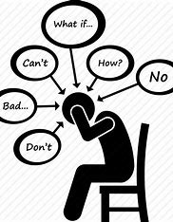
Negative Thinking Glasses - Start with the thoughts !
Magnifying Glasses: everything seems bigger, more important, more dangerous.
‘My life will be over if I don’t pass this test, my parents will hate me
Make Believe Glasses: imagining things to be true
‘I don’t fit in, I don’t look like anyone else, I don’t want to go out’
Fortune Telling Glasses: Bad things will happen, worst case scenario thinking
‘Year 7 will be awful, I wont make new friends, I wont want to go’
What If Glasses: what if this bad thing happens, what if that bad thing happens
‘My friend has been sick, what If Im ill now, what if I'm sick in school’
‘Mind Reading Glasses: other people thinking negative thoughts about you
‘My teacher looks at me funny, they don’t like me and think I'm stupid’
Doom & Gloom Glasses: seeing the worst in everything, focus on the negative everything will go wrong
‘I'm rubbish, I never get picked for football so why should I try’

Slide 14
Frequently thinking negatively and unrealistically about learning, school work and tests causes other cognitive symptoms – we can often feel like our minds have gone blank.
We can find it hard to:
Concentrate, focus and pay attention
Retrieve information from our memory
Understand information: comprehension
Follow processes and sequences
Gather our thoughts into a logical and clear format
Put our thoughts down on paper or say them our loud in a reasoned and clear way

Slide 15
Accepting our thoughts are only thoughts:
Ditching the Thinking Glasses
What am I thinking ??
Is this thought helpful right now
Which glasses am I wearing
Is my thought based on fact
Have I evidence to back up this thought
What is the worst thing that could happen, is it likely?
Can I think more realistically, based on fact
What is more likely to happen

Slide 16
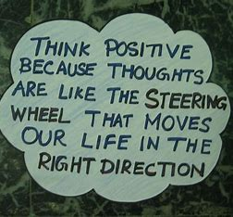
Test Stress Box
My unrealistic expectations about work, revision and exams
Alternative, realistic expectations
It will be too hard, I wont know the answers
I’m going to panic and get it all wrong
I’ll just fail, I’m trying, but I’ll fail
I've revised, I will know at least some of it !
I know how to self care, I did well in practice, I can manage this
Everyone knows I'm working hard, they know I’ll do my best and that is enough

Slide 17
In a calm moment, talk with your child about their anxiety. Ask them what it feels like in their mind and body, and what things make them feel that way. It can be tempting to dismiss their worries because you want to reassure them, but it’s important to empathise with their experience and validate their feelings.
From an NSPCC study, young people said they didn’t talk to their parents because:
They wouldn’t understand
They would over-react
They would become worried or upset
They would not be believed
To discuss their worries with someone they needed:
To be listened to
To know that person could help
Not to be judged
Not to be told off
Not to have that person take control

Slide 18
In the moment
To relax
Walk or step outside to get some fresh air
Exercise or physical activity
Breathe deeply
Visualise
Listen to music
Colour or draw
Soothe box
To distract
Watch a film
Play a game
Activity with family
Read
Meet or speak to friends
Do something physical

Slide 19
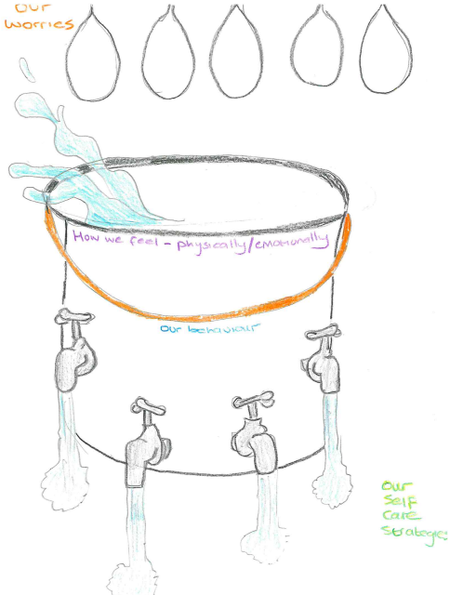
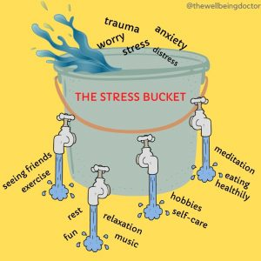
It might feel like the smallest thing causes our bucket to overspill

Slide 20
Give permission
Connect
Emotion Coaching
Label
Empathy and understanding
Validate
Problem solve

Slide 21
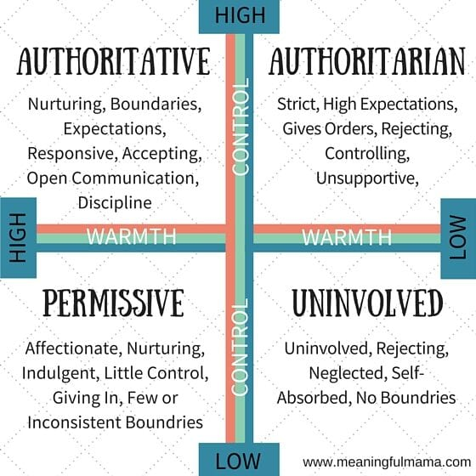
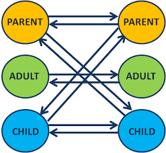

Slide 22
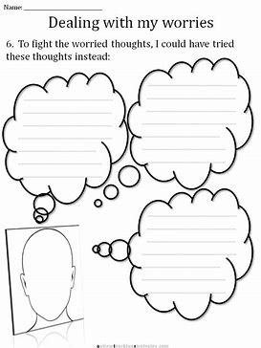
Challenging the thoughts -

Slide 23
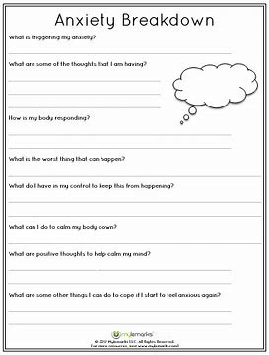
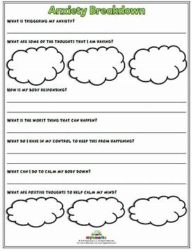
Breaking it down

Slide 24
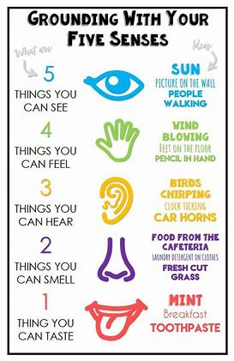
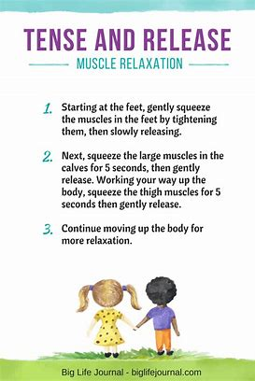
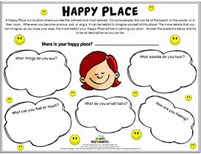
Make a self soothing box

Slide 25
Self Care We need to manage our own anxieties in order to react calmly, model behaviour and emotional responses

Slide 26
Anxiety UK
Provides information, support and advice for anyone struggling with anxiety.
Live chat service available.
Phone: 03444 775 774
Text: 07537 416 905
Email: support@anxietyuk.org.uk
Opening times: 9.30am-5.30pm, Monday-Friday

Slide 27
Young Minds https://www.youngminds.org.uk/parent/parents-a-z-mental-health-guide/
If you are a parent or carer worried about your child
Speak to our experts at the Parents Helpline
Call for free on 0808 802 5544 (9:30am - 4pm, Mon - Fri).
Email using our Parents Helpline contact form.
Use our live Parents webchat service (9:30am - 4pm, Mon – Fri)
Pooky Knightsmith Mental Health – YouTube

Slide 28
https://www.mpft.nhs.uk/services/health-visiting-and-school-nursing/staffordshire-clinics/what-we-offer
https://camhs.mpft.nhs.uk/south-staffordshire/self-referral-mental-health-support
https://www.staffordshire-ewb.actionforchildren.org.uk/

Slide 29
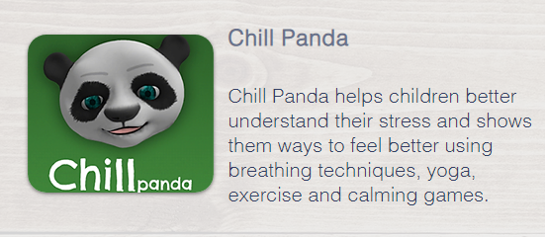
APPS | CAMHS Resources (camhs-resources.co.uk)
Wellbeing apps for kids | Internet Matters

