Slide 1
Teach reading: change lives
Parent workshop: Phonics and early reading in Reception, Phase 2
(Autumn 1)
Notes:
For this presentation, you will need to download and print out the following resources and information for parents:
Phase 2 grapheme information sheet – Autumn 1
the parent handout ‘Your child’s reading journey – Reception Autumn term’
the Phase 2 and 3 grapheme mat
the Little Wandle Progression overview
‘Phase 2 tricky words: Reception Autumn term – Information for parents and carers’ – or parents can access this in the ‘For parents’ area of the Little Wandle website.
You will need a flipchart and access to the Little Wandle and Collins websites.
You may also wish to have a copy of the Little Wandle Glossary to hand (in Getting started/Teaching).

Slide 2
A love of reading is the biggest indicator of future academic success.
OECD (The Organisation for Economic Co-operation and Development)
Notes:
Slide purpose:
To share the link that research has established between loving reading and being successful academically
Suggested script:
Let's start our session with a quote from the Organisation for Economic Co-operation and Development ...
Read the quote.
This quote reminds us of the importance not just of teaching children to read, but also of teaching them to love reading.
Today, we're going to talk about phonics, but we always see phonics as the route into reading and a love of reading as the ultimate goal of phonics teaching.

Slide 3
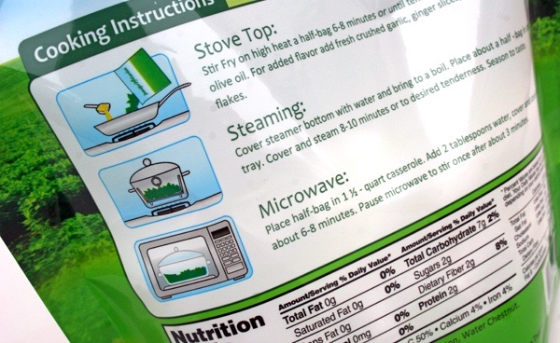
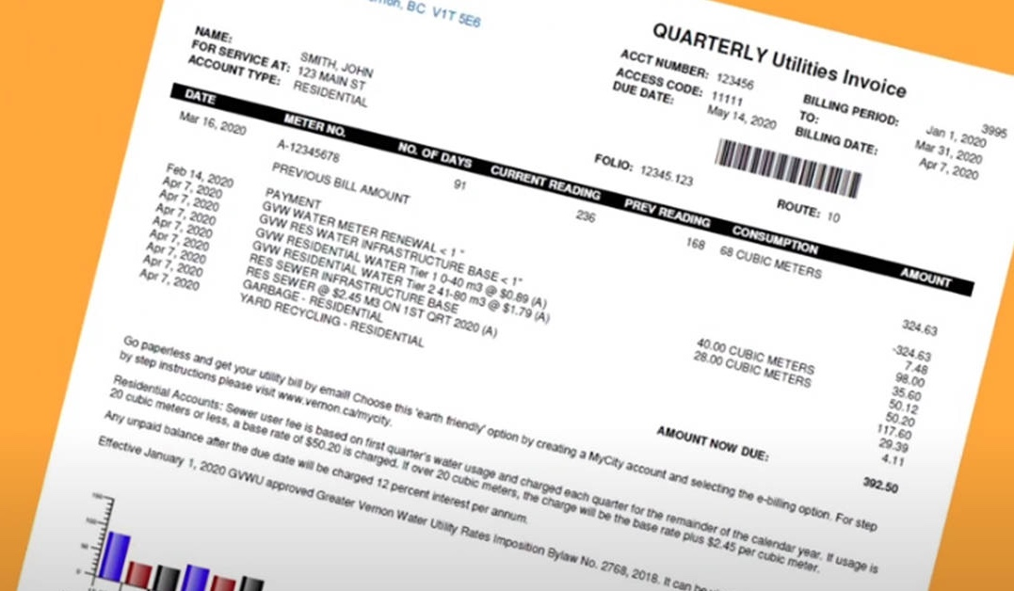
How many times have you already read today?
Notes:
Slide purpose:
To help parents see the value of reading by getting them to reflect on their own reading experiences
Suggested script:
Just think about how many times you have already read things today. More than ever, we are surrounded by text and reading is a vital skill.
We want all of our children to become confident readers who can navigate the world of reading around them.

Slide 4
Phonics

Slide 5
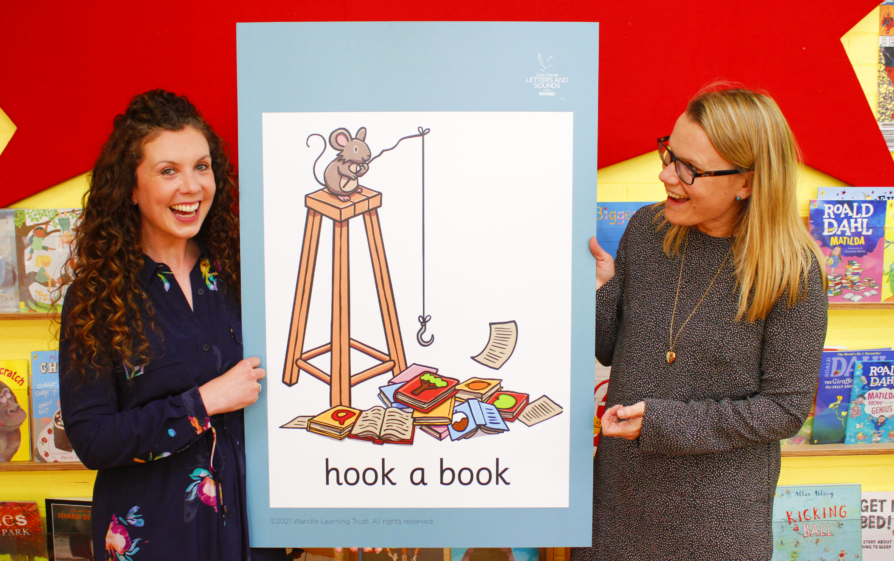
Little Wandle Letters and Sounds Revised
Our school has chosen Little Wandle Letters and Sounds Revised as our Systematic Synthetic Phonics (SSP) programme to teach early reading and spelling.
Notes:
Slide purpose:
To inform parents that all schools must teach phonics in Reception, but explain your school's choice of SSP
Suggested script:
The National Curriculum specifies that all schools must teach children to read using phonics in Reception.
Read the slide.

Slide 6
Phonics is:
making connections between the sounds of our spoken words and the letters that are used to write them down.
Notes:
Slide purpose:
To provide a simple definition of phonics
Suggested script:
So what is phonics?
Read the slide.
It sounds complicated but it really isn’t!
Let's learn some important words that will help you understand phonics ...

Slide 7
Terminology
Phoneme
Blend
Grapheme
Segment
Digraph
Trigraph
Notes:
Slide purpose:
To give simple definitions of key terminology
Notes:
Explain what each word means – use the Glossary to help.

Slide 8
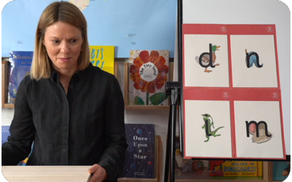
This term we are teaching Phase 2
These are the first group of letters and sounds your child will learn.
We start teaching from week 2 of Reception.
The lessons are fun, interactive, engaging and have been designed to gradually build over time.
Notes:
Slide purpose:
To introduce Phase 2
Notes
Read the slide.

Slide 9
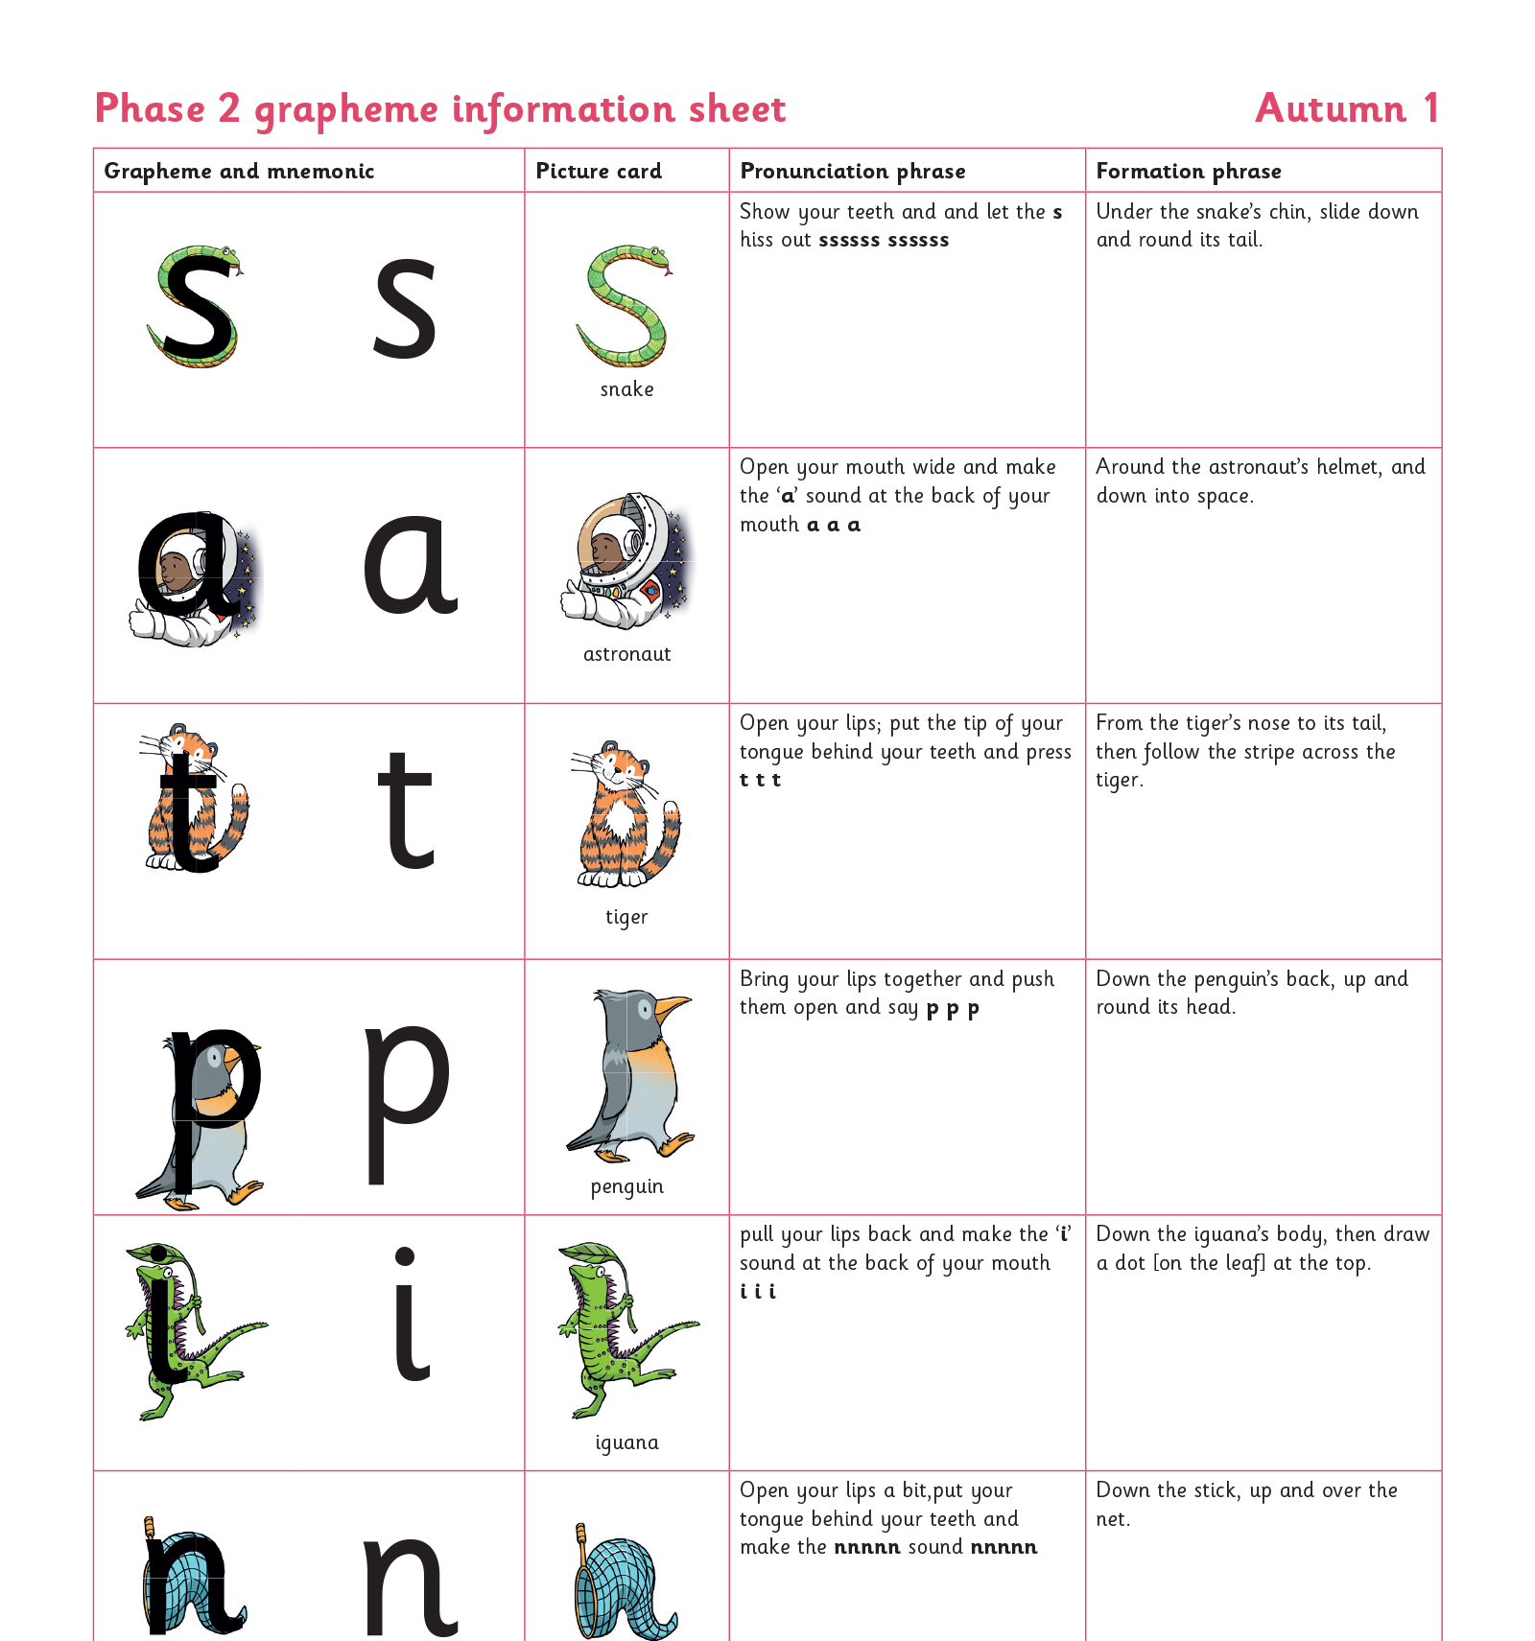
We teach Phase 2 in this order
Notes:
Slide purpose:
To provide an overview of the Phase 2 sounds
Suggested script:
We usually teach four new sounds a week and have a review lesson on a Friday.
You will get a list of the sounds that we are learning to have at home. This will help you with letter formation (handwriting) and pronunciation.
Give the Phase 2 grapheme information sheet for Autumn 1 to parents.

Slide 10
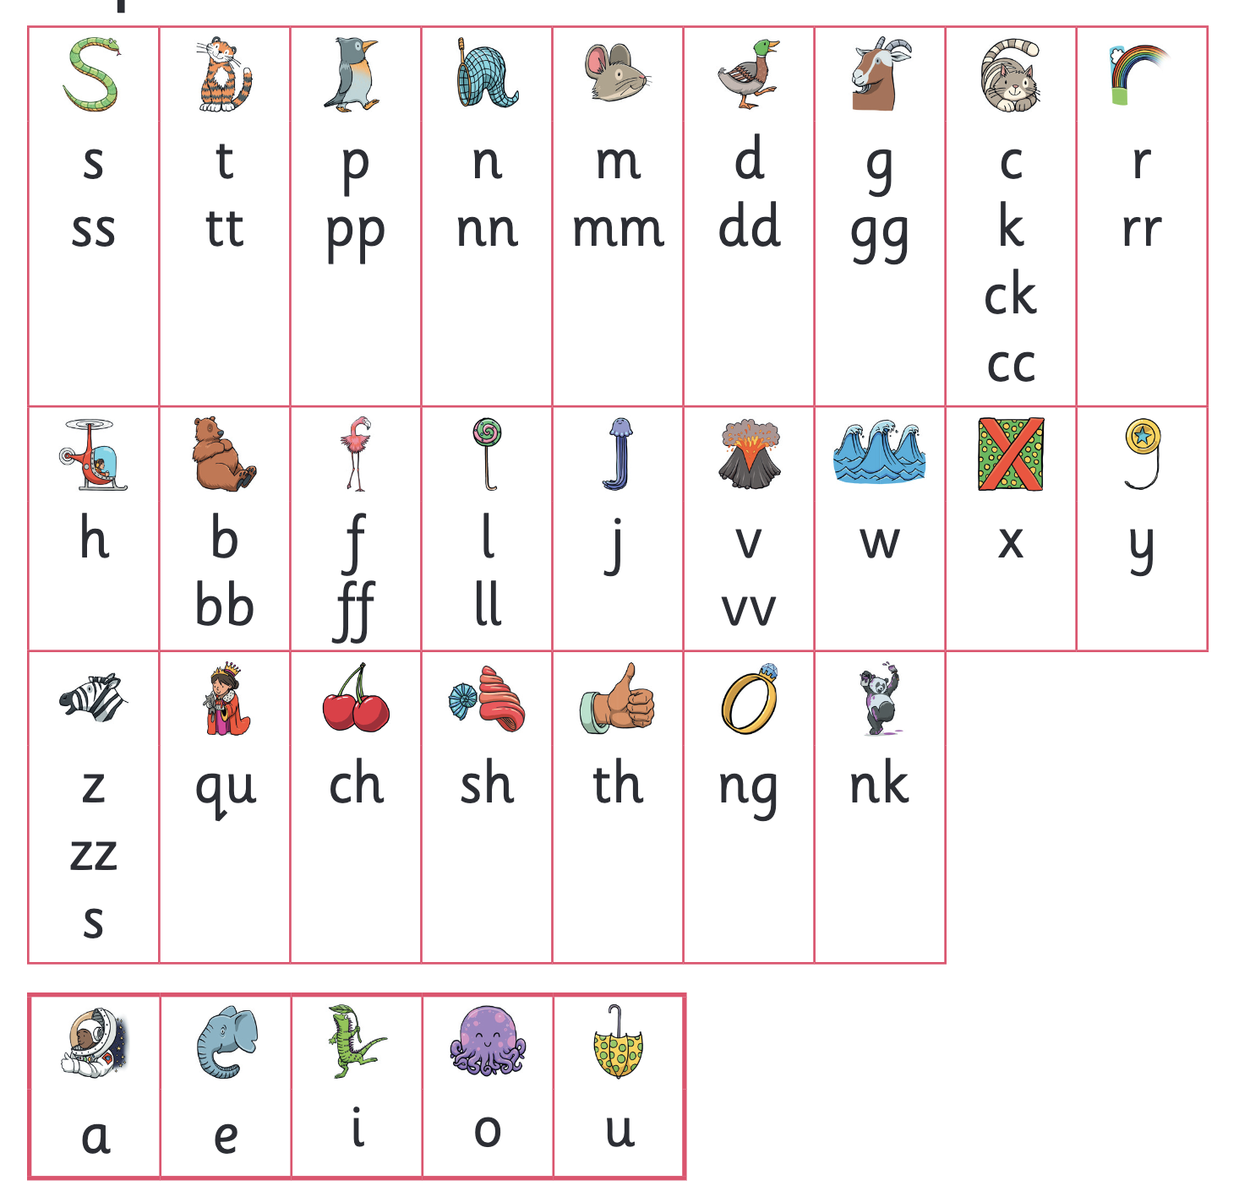
Let’s say the Phase 2 sounds
Notes:
Slide purpose:
To practise the Phase 2 sounds
Notes
Give out the parent handout and the Phase 2 and 3 grapheme mat.
Play the videos/teach the parents to say the Phase 2 sounds: https://www.littlewandlelettersandsounds.org.uk/resources/for-parents/
Show parents where to access these videos in the ‘For parents’ area of the Little Wandle website.

Slide 11
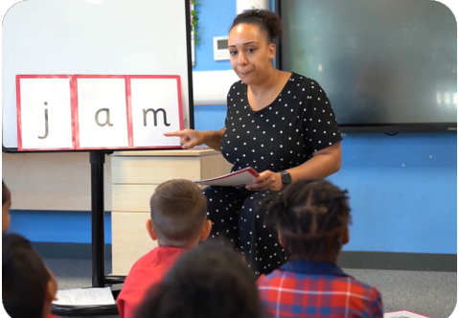
We teach blending so your child learns to read
Teacher-led blending is taught throughout Phase 2.
Our aim to is to teach every child to blend by Christmas.
We will inform you if your child needs additional practice.
Notes:
Slide purpose:
To introduce blending
Suggested script:
Teacher-led blending is teaching children how to blend, directed and demonstrated by the teacher.
It is repeated daily in the Autumn term.

Slide 12
Blending to read words
Notes:
Slide purpose:
To provide an overview of blending
Suggested script:
Some children learn to blend really quickly, and others take a little longer.
If your child is finding it difficult, ask your child’s teacher for ways to help at home – playing blending games at home is so helpful!
Show parents the ‘How we teach blending’ video from ‘For parents’ area of the website: https://www.littlewandlelettersandsounds.org.uk/resources/for-parents/

Slide 13
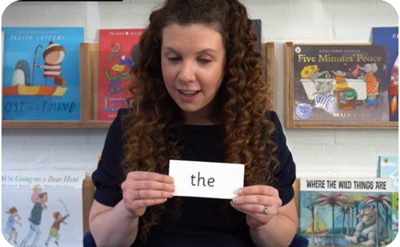
Tricky words
These words have unusual spellings e.g. he, the, was.
They are taught in a systematic way.
Children are now learning to read the Phase 2 tricky words: is, I, the, put, pull, full, as, and, has, his, her, go, no, to, into, she, push, he, of, we, me, be.
Notes:
Slide purpose:
To introduce tricky words
Notes:
Read the slide.
You may wish to give parents a copy of the document ‘Phase 2 tricky words: Reception Autumn term – Information for parents and carers'.

Slide 14
Reading tricky words
Notes:
Slide purpose:
To provide an overview of tricky words
Notes
Watch the ‘How we teach tricky words’ video on the website: https://www.littlewandlelettersandsounds.org.uk/resources/for-parents/

Slide 15
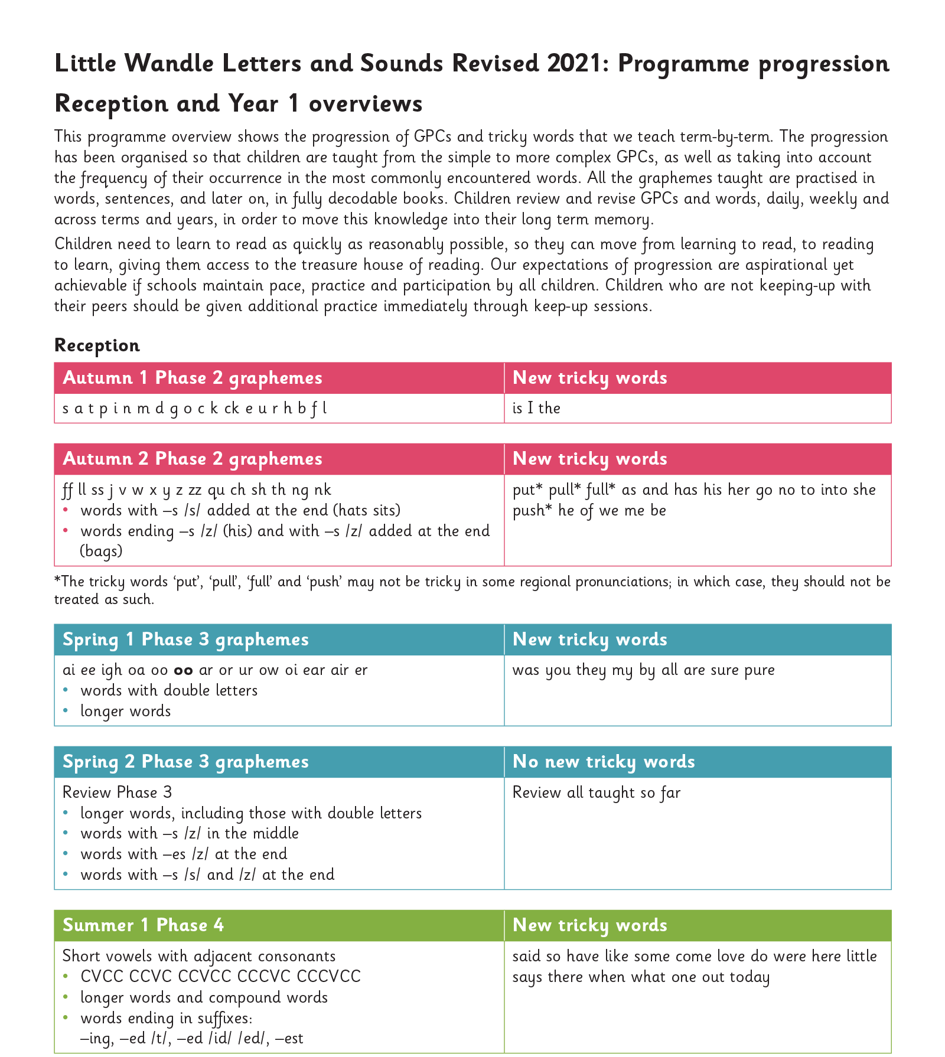
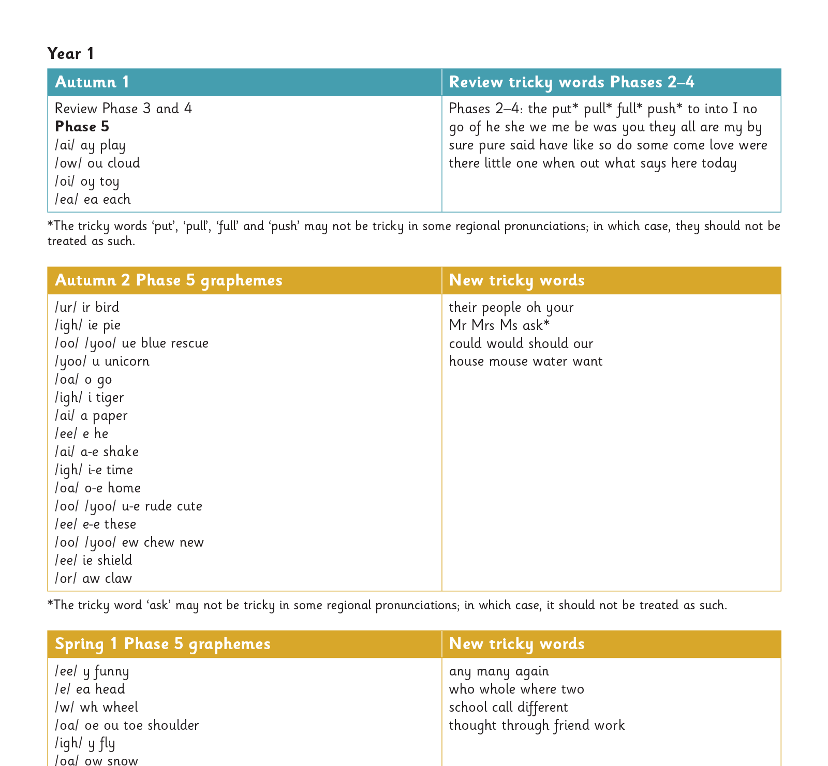
Our progression
Notes:
Slide purpose:
To provide an overview of the whole programme’s progression
Suggested script:
We will work our way through the whole Little Wandle Programme until your child can read fluently.

Slide 16
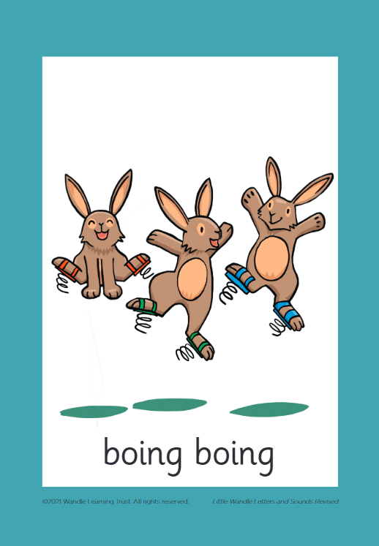
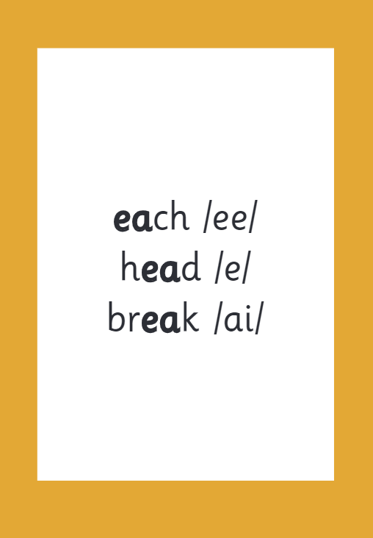
How we make learning stick
Notes:
Slide purpose:
To provide an overview of the programme’s efficacy
Suggested script:
There are specific resources for the Little Wandle Programme which the children will be very familiar with.
Each sound that we teach to begin with has either a mnemonic (like the astronaut that you can see here) or a phrase like boing-boing for ‘oi’. This helps the children recognise and remember the graphemes.
Every time we teach a new sound, we also read words during the phonics lesson that contain that new sound so that the children practise what they have learned.
We then go on to reading a sentence containing some of those words.
We have displays in the classroom and on the tables to support the children throughout the day.

