Slide 1
Welcome to Christ Church Primary School
New Parents’ Meeting
June 20th 2024

Slide 2
School Attendance
We strive for all of our children to have 100% per cent attendance and we continually reinforce to our pupils the importance of being in school. If a child has above 97% attendance, then they are giving themselves the best opportunity to achieve not only now but also in the future. Falling below 90% attendance means your child has had four whole weeks off school during the school year. This level of attendance means your child will struggle with their school work because they have had the equivalent of one day off every fortnight!

Slide 3
Key information
School day:
Gate opens 8:35am closes 8:50am
Lates logged 8:45am Registration closes 9:15am
Parents are expected to call into school on each day of absence. If a reason for absence is not reported this goes down as unauthorised absence.
All appointment cards need to be shared with school
Medical information needs to be shared with school
Why is it important?
The reason to start good attendance practice now is:
To reduce anxiety,
Reduce the impact of having to enter through main reception,
Reduce the impact of entering class when all pupils working,
Reduce the impact of missing learning,
Developing good patterns now so that there is little impact for secondary education

Slide 4
What are we doing in school?
Little Heroes
We have launched a new initiative called- Little Heroes. This initiative has been rolled out in school across Staffordshire to help encourage good school attendance.
Each day the children across EYFS and KS1 will receive a tick on their class chart if they are in school and on time. At the end of the week, they will get a sticker if they have completed the week. The children, who are in school and on time everyday, will receive a certificate at the end of the month.
In our May newsletter on the school website you can click the link to find out more.
Helpful heroes - parents guide (canva.com)

Slide 5
What can you do to help?

Slide 6
Support
Support
Within school : Class teacher, Mrs Dunn (family liaison worker), Headteacher, MHST, HOPE
Malachi, Early Help, Social Services
Parenting courses at East Staffordshire Children Centre
School Nurse 0-19 Health Team
GP
Action for Children
CAMHS
Community groups such as Beyond Black Belt, Burton Albion Community Trust, Guiding Association, Dance groups
Department for Education School attendance and absence: Help with getting your child to go to school - GOV.UK (www.gov.uk)
Working together to improve school attendance (applies from 19 August 2024) (publishing.service.gov.uk)

Slide 7
The Curriculum
Communication and Language
Personal, Social and Emotional Development
Physical Development
Literacy
Mathematics
Understanding the World
Expressive Arts and Design

Slide 8
Foundation Stage
What is the Foundation Stage?
The Foundation Stage is the stage of education for children from birth up to the end of the Reception year.
The Foundation Stage Curriculum is based on the recognition that children learn best through play and active learning.
The reception year is the final year of the Foundation Stage

Slide 9
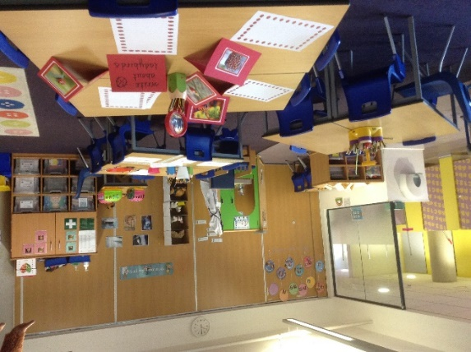
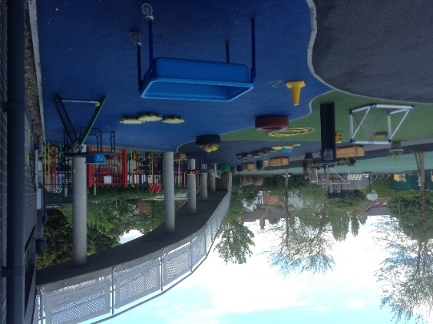
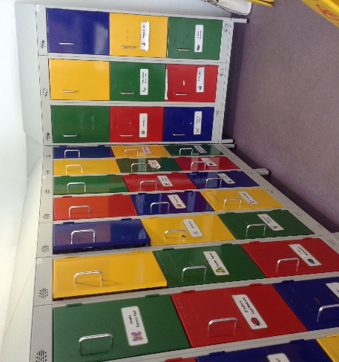
Our Reception Classrooms
The children are organised into two classes with 23 children in each.
We have large folding doors that create a flexible space
We have toilets within the classroom space and children are able to use them as required.
The children have a locker to keep their coats and other belongings.
The outside space is used daily and supports the learning that takes place indoors.

Slide 10
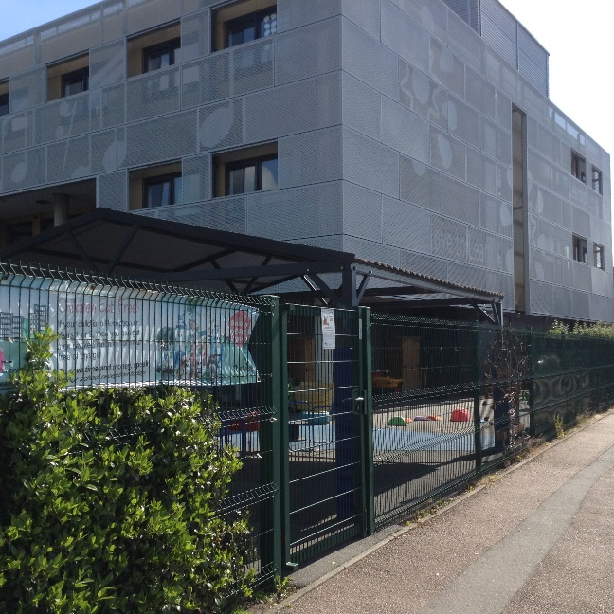
Arriving at school and Home- time Collection
Reception children enter and leave our school site through the side gate on Dale Street.
Arrival times are staggered with other year groups to ease congestion.
Arrival time for reception children is 8.45 am.
Collection time for reception children is 3.10pm.
Please inform us if a different person will be collecting your child.

Slide 11
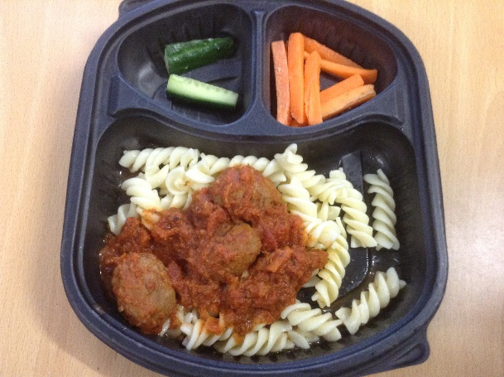
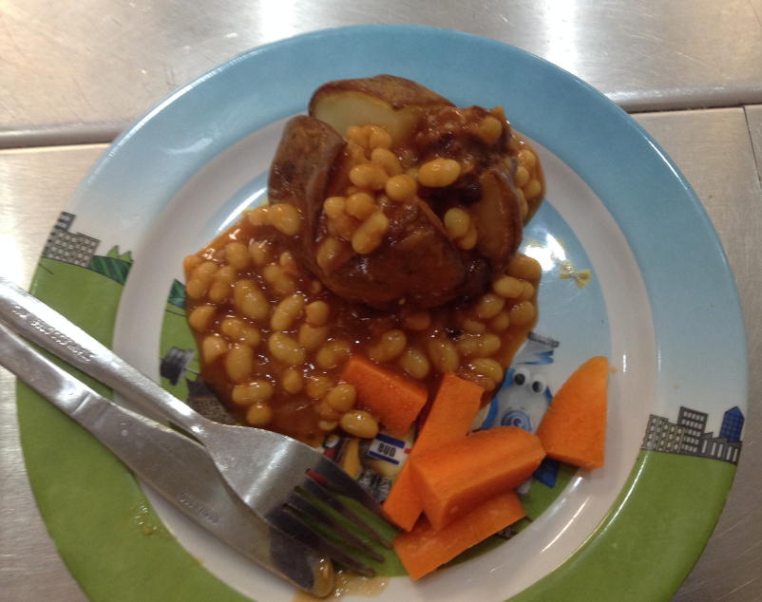
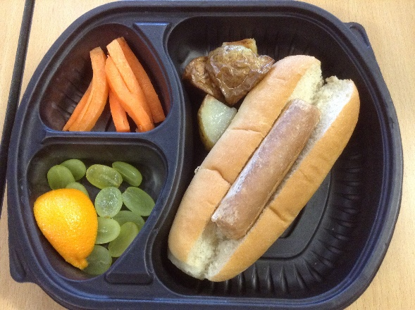
Snacks & Lunch time
During the morning session, your child will be provided with a fruit or vegetable snack and a choice of milk or water.
In reception and KS1, all lunches are provided for free. You will receive a menu so that you can discuss the choices available with your child.
Your child will make a choice each day and tell their teacher at register time.
They can choose from different options and vegetarian choices are available daily.

Slide 12
Allergies
If your child has medically diagnosed allergies, please let us know as soon as possible and add this information to the admission sheet in your pack
Our caterers are Edwards and Ward and they will also need this information as soon as possible via their website (information is in your pack)
They will then create a bespoke menu for your child

Slide 13
Uniform
Our uniform comprises of:
A red jumper or cardigan
A white shirt, blouse or polo - shirt
Grey trousers, skirt or pinafore
Red gingham dresses may be worn in summer
Black, grey or white socks or grey tights
Black shoes (no trainers)
A book bag
A water bottle
Stud earrings only. No other jewellery
ALL UNIFORM SHOULD BE NAMED
Affordable Clothing rail

Slide 14
PE Kit
Our PE kit comprises of:
A plain white T-shirt
Plain black shorts or leggings
Black pumps or black trainers
No earrings
Pupils will come to school wearing kit on their PE day. Staff will notify you of PE days in September.

Slide 15
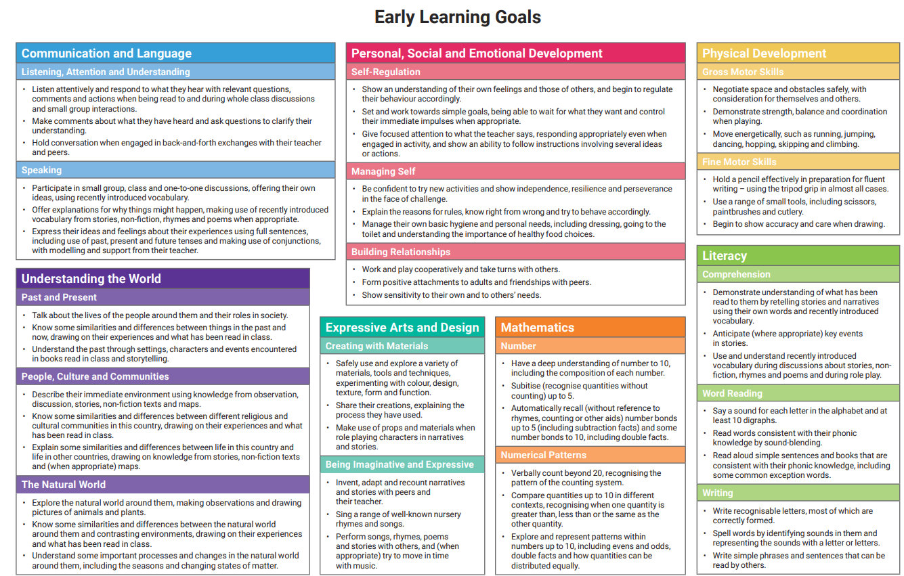
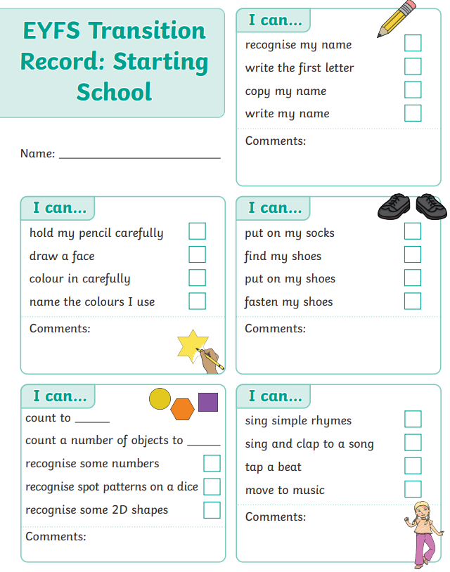
In your pack
In your pack you will find:
A pack of forms. These should be returned to the office when you come to school for your transition day session or by July 12th at very latest. Please can you bring your child’s birth certificate with you.
School readiness information
Early Learning goals
Transition Record – please bring this on transition day

Slide 16
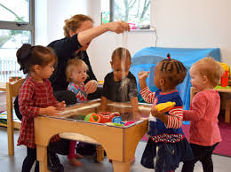
Transition event
Nursery Visits
Aim of visits is to make the transition from home or nursery as smooth as possible so our pupils are happy to start school and settle quickly into school life
Nursery visits have been carried out for all children
We have had the opportunity to observe your child in their current setting and/or talk to staff in order to gather as much information about them as we can

Slide 17
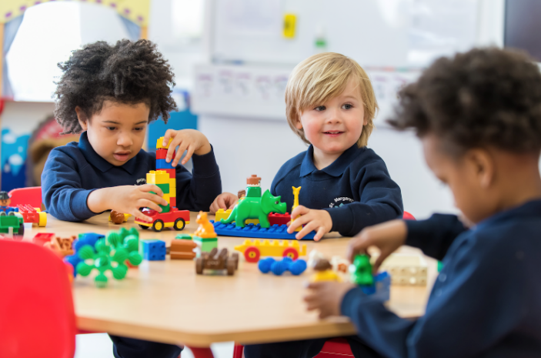
Transition event
School session – Wednesday 3rd July
Spend the morning/afternoon in the setting with their new teacher and friends
Information on your session is in your pack
Arrive at the office and hand in paperwork
Accompany children into the classroom
Collect from the office at the end of the session

Slide 18
Visit the classrooms
Thank you for your time
These slides are available on the website
Please collect your child and come and visit the classrooms and meet our teaching staff/SENDco.
Opportunity to ask any questions you may have

