Slide 1

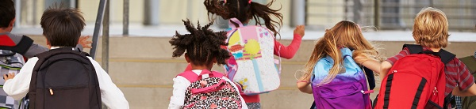
Welcome to Christ Church Primary School
New Parents’ Meeting
June 15th 2026

Slide 2

Foundation Stage
What is the Foundation Stage?
The Foundation Stage is the stage of education for children from birth up to the end of the Reception year.
The Foundation Stage Curriculum is based on
the recognition that children learn best through
play and active learning.
The reception year is the final
year of the Foundation Stage
Notes:
Already part of foundation stage

Slide 3

The Curriculum
Communication and Language
Personal, Social and Emotional Development
Physical Development
Literacy
Mathematics
Understanding the World
Expressive Arts and Design

Slide 4
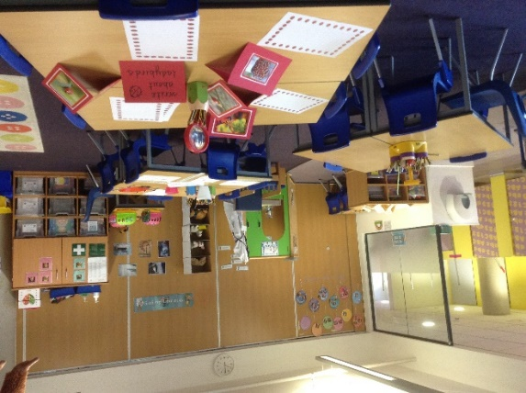
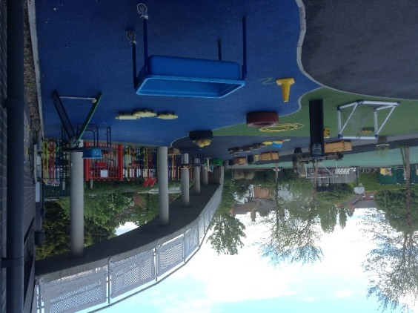
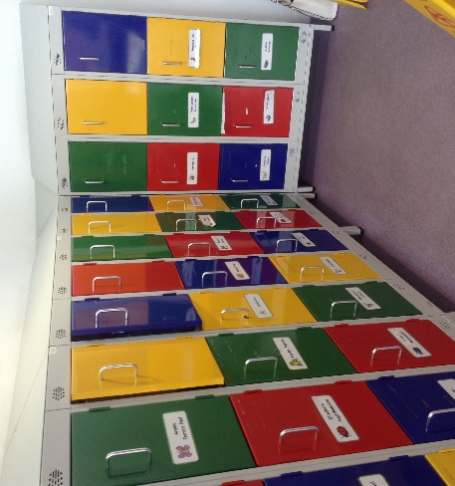
Our Reception Classrooms
The children are organised into two classes with 23
children in each.
We have large folding doors that create a flexible space
We have toilets within the classroom space and children
are able to use them as required.
The children have a locker to keep their coats and other belongings.
The outside space is used daily and supports the learning that takes place indoors.
Notes:
If your child has toileting issues – please see member of staff so that we can prepare an intimate care plan
All children should have a change of clothes in their school bag in case of accidents

Slide 5
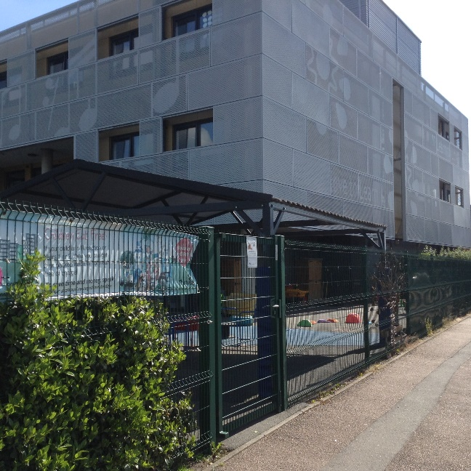
Arriving at school and
Home- time Collection
Reception children enter and leave our school site through the side gate on Dale Street.
Arrival times are staggered with other year groups to ease congestion.
Arrival time for reception children is
8.45am.
Collection time for reception children
is 3.10pm.
Please inform us if a different person
will be collecting your child.

Slide 6
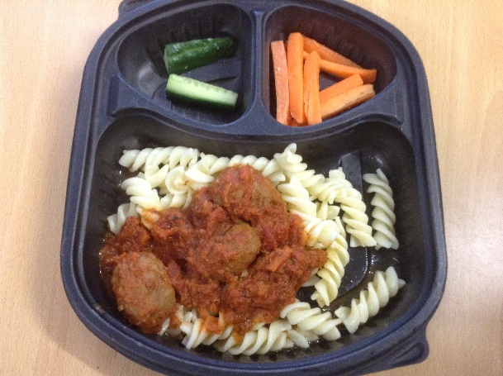
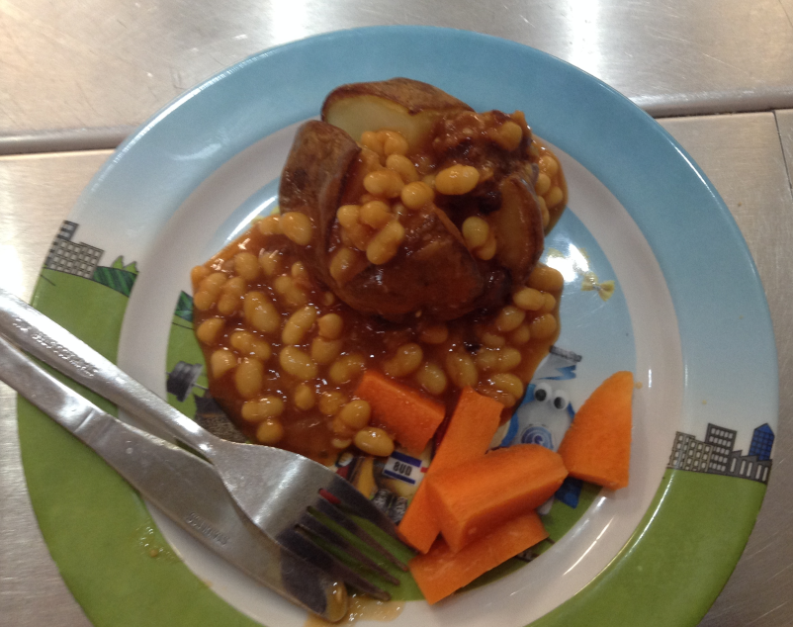
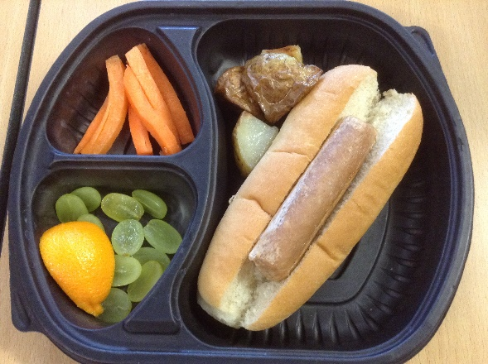
Snacks & Lunch time
During the morning session, your child will be provided with a fruit or vegetable snack and a choice of milk or water.
In reception and KS1, all lunches are provided for free. You will receive a menu so that you can discuss the choices available with your child and these are available on our website.
Your child will make a choice each day and tell their teacher at register time.
They can choose from different options and vegetarian choices are available daily.
Notes:
See Edwards and Ward to sample foods and discuss how allergies are catered for
Good if your child is able to talk about the foods that they like/dislike
Willing to try new food
Know lots of concerbs about food – please see a member of staff

Slide 7


Allergies
If your child has medically diagnosed allergies, please let us know as soon as possible and add this information to the admission sheet in your pack
Our caterers are Edwards and Ward and they will also need this information as soon as possible via their website (information is in your pack)
They will then create a bespoke menu for your child
Notes:
Fill in all information in your pack and let us know on induction day
If you need help – please see a member of staff or the office staff will be happy to help you

Slide 8

Our School Values

Slide 9
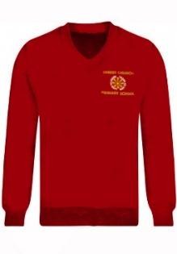
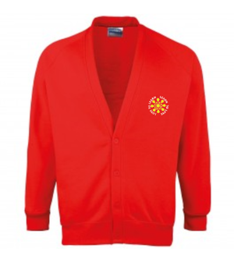

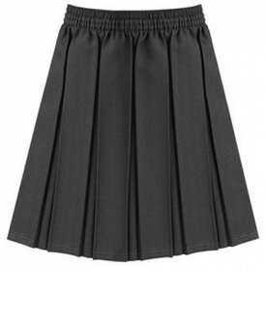
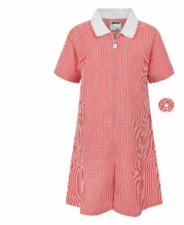
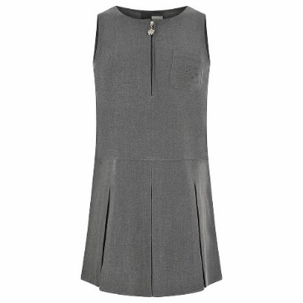
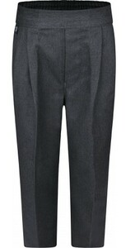
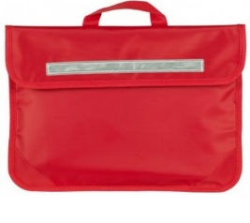



Uniform
Our uniform comprises of:
A red jumper or cardigan
A white shirt, blouse or polo - shirt
Grey trousers, skirt or pinafore
Red gingham dresses or smart shorts
may be worn in summer
Black, grey or white socks or grey tights
Black shoes (no trainers)
A book bag
A water bottle
Stud earrings only. No other jewellery
ALL UNIFORM SHOULD BE NAMED
Affordable Clothing rail
Notes:
Available lots of places
No need for school logo
Affordable rail in reception
NAME everything

Slide 10

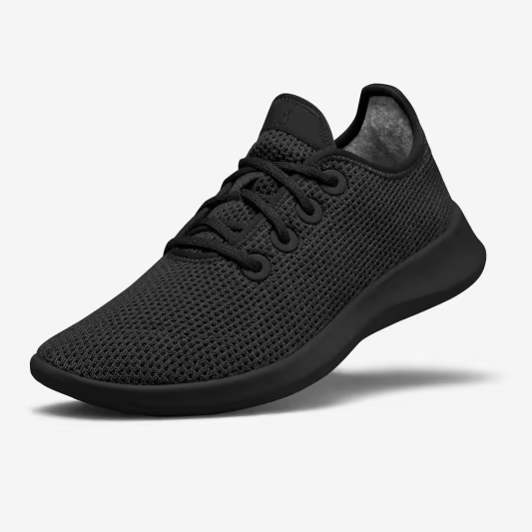

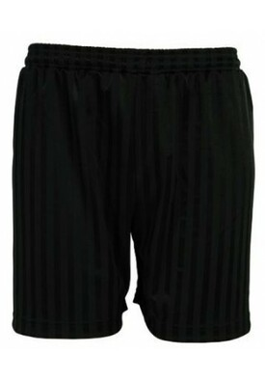
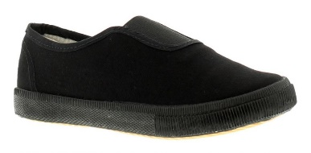
PE Kit
Our PE kit comprises of:
A plain white T-shirt
Plain black shorts or leggings
Plain black sweatshirt/hoodie
Black pumps or black trainers
No earrings
Pupils will come to school wearing kit on their PE day. Staff will notify you of PE days in September.

Slide 11


Wrap around Care
Breakfast Club: The breakfast club runs daily from 8.00am-8.45am during term time. Progressive will ensure the children are well fed and hydrated in readiness for the school day. After they’ve eaten they’ll have time to play with their friends and free flow through a range of activities.
After School Club: The After School Club runs daily from 3.15 to 5.30pm during term time.(Please check with Progressive directly for any changes) Progressive will ensure that the After School Club is a great extension to the school day offering the children with a fun, relaxed and enriching activities to enjoy. Children will be able to free flow through 4 zones and enjoy a range of activities and games. Children will also enjoy a light snack and refreshments to keep them going.
Further information is available on our website
Notes:
Extra information for how to book is on website

Slide 12
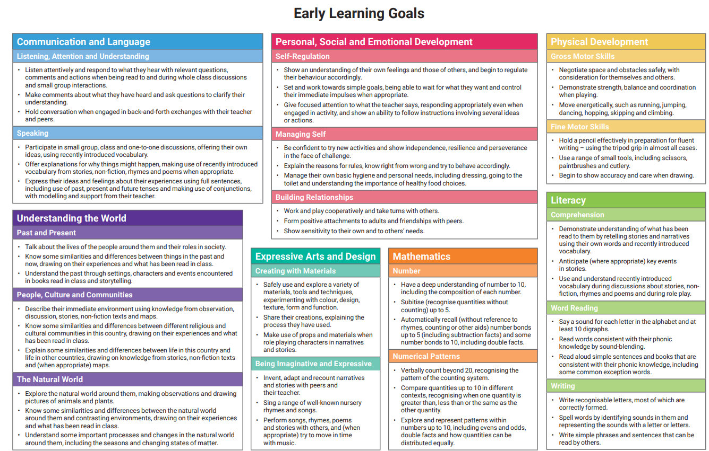
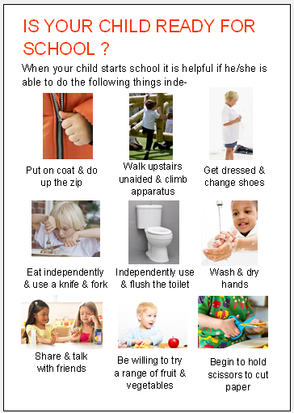
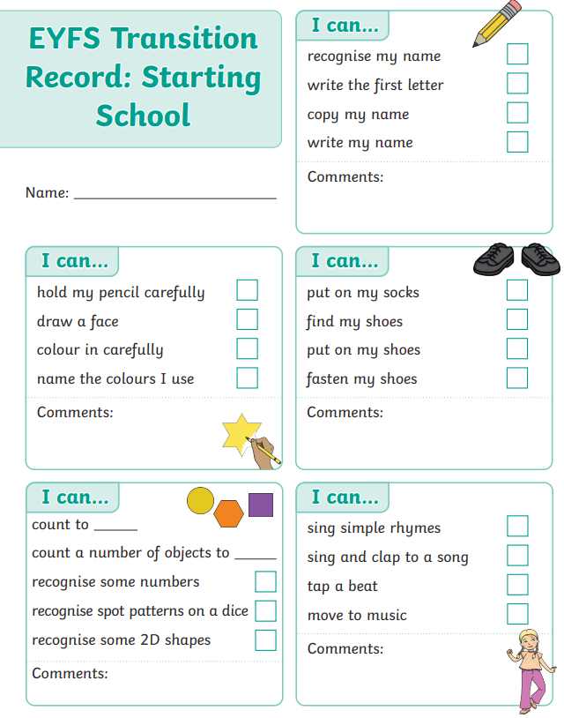
In your pack
In your pack you will find:
A pack of forms. These should be returned to the office when you come to school for your transition day session or by July 11th at very latest.
Please can you bring your child’s
birth certificate with you.
School readiness information
Early Learning goals
Transition Record – please
bring this on transition day

Slide 13
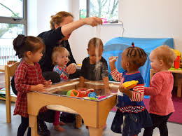
Transition events
1. Nursery Visits
Nursery visits have been carried out for all children
Aim of visits is to make the transition from home or nursery as smooth as possible so our pupils are happy to start school and settle quickly into school life
We have had the opportunity to observe
your child in their current setting
and/or talk to staff in order to gather
as much information about them as
we can
Notes:
If there is anything that you feel we need to know, please speak to a member of staff tonight

Slide 14
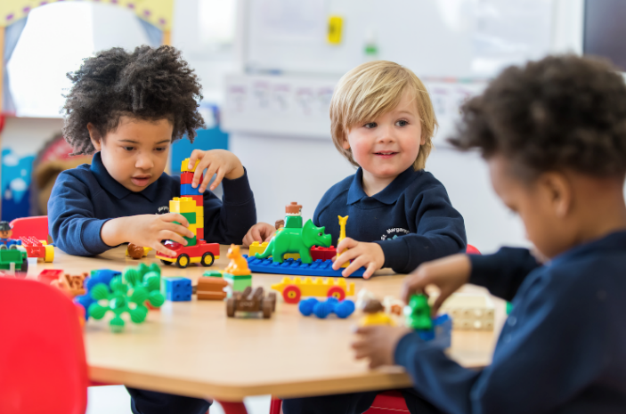
Transition event
2. School session – Wednesday 1st July
Spend the morning/afternoon in the setting with their new teacher and new classmates
Information on your session is in your pack
Arrive at the office and hand in paperwork
Accompany children into the classroom
Collect from the office at the
end of the session
Notes:
All times are in your pack

Slide 15

September school start date
    Your child will start school full time on Thursday 3rd September 2026
Notes:
Gives a gradual start to the school year

Slide 16
Visit the classrooms
Thank you for your time
These slides are available on the website
Please collect your child and come and visit the classrooms and meet our teaching staff
Opportunity to share any
information and ask any
questions you may have

